Slide 1
Name of Capstone Project
Fraud Detection in Mobile Financial Transactions Using Machine Learning

Slide 2
Project Overview
This project aims to enhance the accuracy of detecting fraud in mobile financial transactions using machine learning techniques.
The objective is to develop a robust predictive model capable of identifying fraudulent transactions in real-time, enabling organizations to:
• Improve transaction security • Reduce financial losses • Gain insights into fraud patterns • Support data-driven decision-making

Slide 3
Project Structure
Fraud-Detection-ML-Project/ │ ├── data/ │ ├── raw/Fraud_Analysis_Dataset.csv │ └── processed/fraud_predictions.csv │ ├── notebooks/ │ └── Fraud_Detection_Analysis │ ├── src/ │ ├── preprocessing.py │ ├── train.py │ ├── evaluate.py │ └── main.py │ ├── models/ │ └── fraud_model.pkl │ ├── reports/ │ ├── Fraud_Detection_Presentation.pptx │ └── PowerBI_Dashboard.pbix │ ├── requirements.txt ├── README.md └── .gitignore

Slide 4
Technology Stack
👩‍💻 Programming Language
Python
📊 Data Analysis & Manipulation
Pandas
NumPy
📈 Data Visualization
Matplotlib
Seaborn
Power BI
🤖 Machine Learning
Scikit-learn
Imbalanced-learn (SMOTE)
⚙️ Model Evaluation
Confusion Matrix
Precision, Recall, F1-Score
ROC-AUC
💾 Model Deployment & Storage
Joblib (Model Serialization)
🧪 Development Environment
Jupyter Notebook
VS Code
🔧 Version Control
Git and GitHub

Slide 5
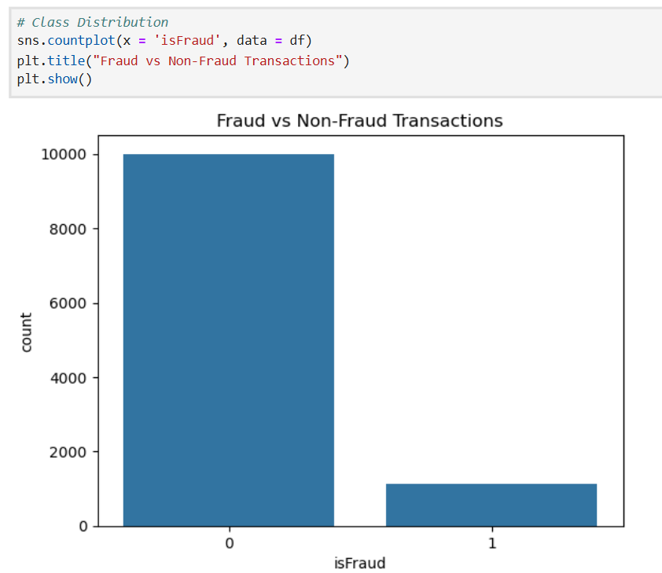
Data Exploration (EDA)
• Performed detailed exploratory data analysis • Used visualizations to identify fraud patterns • Analyzed transaction distributions • Studied correlation between features • Identified class imbalance in fraud cases

Slide 6
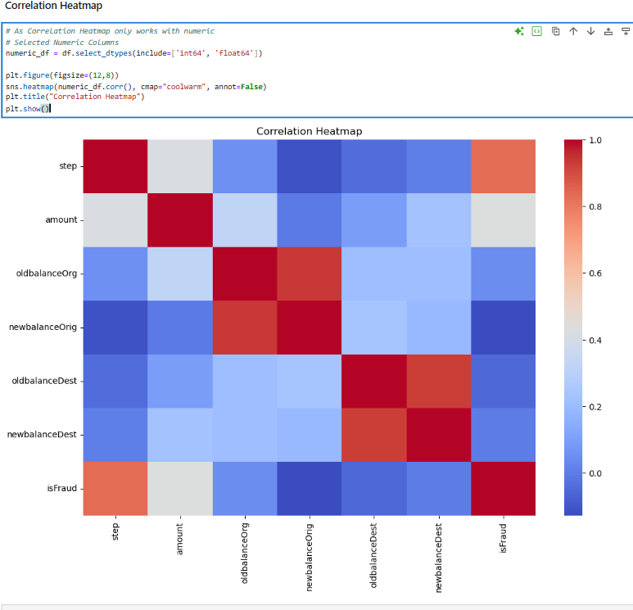
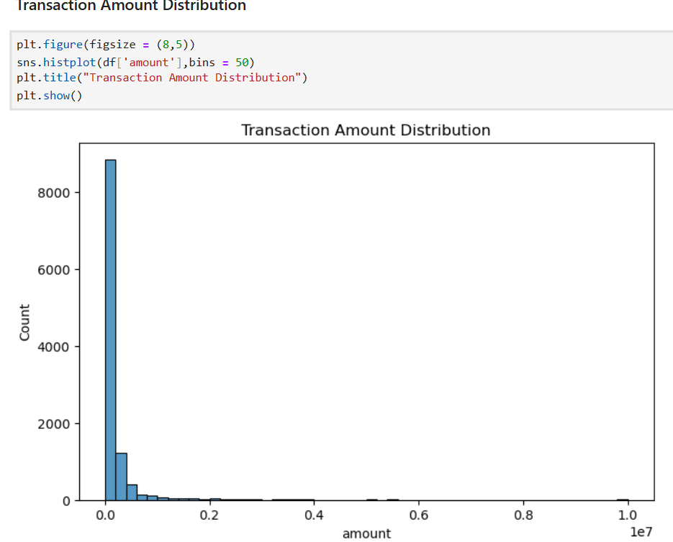
Visuals of EDA

Slide 7
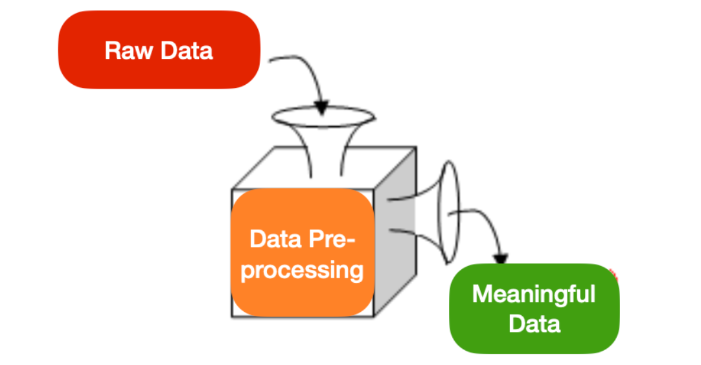
Data Preprocessing
• Handled class imbalance using SMOTE • Scaled numerical features using StandardScaler • Encoded categorical variables • Split dataset into training and testing sets

Slide 8
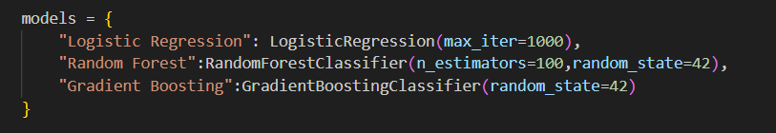
MODEL SELECTION
Machine Learning Models Used:
- Logistic Regression - Random Forest - Gradient Boosting Models were compared based on performance metrics to select the best-performing algorithm.

Slide 9
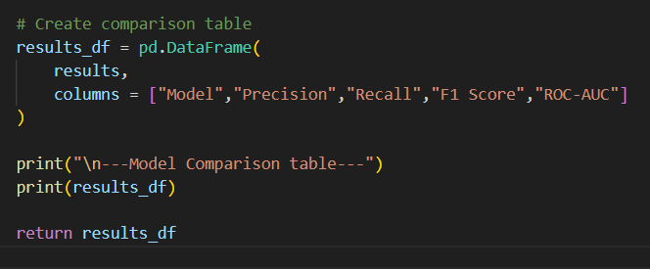
MODEL EVALUATION
📈 Model Evaluation Metrics:
Accuracy
Precision
Recall
F1 Score
ROC-AUC
Confusion Matrix

Slide 10
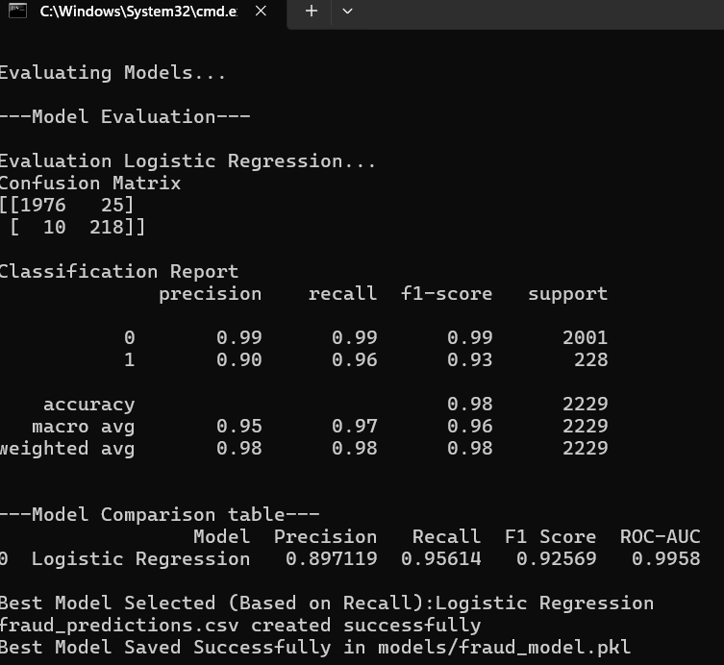
COMPARISION TABLE
Special focus was given to Recall and Precision due to the high cost of missing fraudulent transactions.

Slide 11
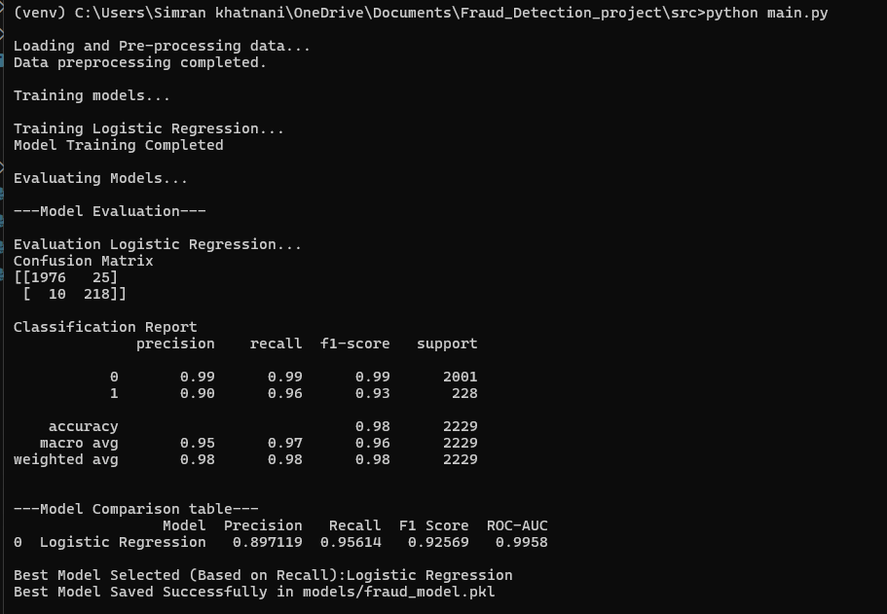
Final Model Selection
After comparing all models based on evaluation metrics, Logistic Regression was selected as the final model.
Reasons for selecting Logistic Regression:
• Achieved the highest overall accuracy (98%) • Provided strong recall (96%), ensuring most fraud cases were detected • Maintained good precision (90%), reducing false alarms • Simple, interpretable, and efficient for real-time fraud detection.
Final Model: Logistic Regression

Slide 12
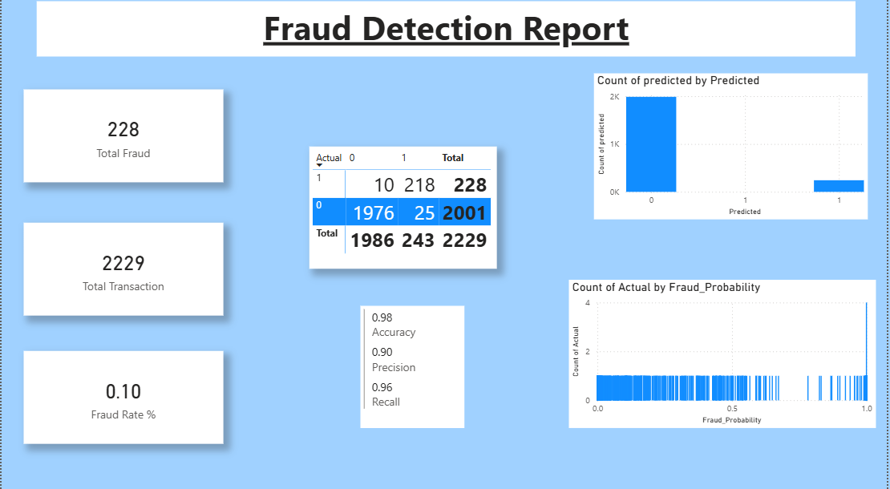
📊 Dashboard
An interactive Power BI dashboard was developed to: - Monitor fraud trends - Track key
performance metrics. - Provide insights to
non-technical
stakeholders

Slide 13
QUESTIONS
1.What is the model's precision and accuracy in detecting fraudulent transactions?
Answer:
The model achieved an overall accuracy of 98%, meaning it correctly classified 98% of all transactions.
For fraudulent transactions specifically:
Precision = 90% → When the model predicts fraud, it is correct 90% of the time.
Recall = 96% → The model successfully detects 96% of all actual fraudulent transactions.
F1-score = 93% → Shows strong balance between precision and recall.
This indicates strong fraud detection performance.

Slide 14
2.How reliable is the model in classifying transactions?
The model is highly reliable because:
It correctly identifies 218 out of 228 fraud cases.
It misses only 10 fraudulent transactions (very low false negatives).
It incorrectly flags only 25 legitimate transactions as fraud.
The high recall (96%) ensures that very few fraud cases are missed, which is critical in financial systems.
The strong accuracy (98%) and F1-score (93%) confirm consistent performance across classes.
Overall, the model provides stable and reliable fraud classification.

Slide 15
3. What are the potential losses due to model errors?
Here are two types of errors:
False Negatives (10 cases)
Fraud predicted as legitimate.
Impact:
Direct financial loss
These 10 transactions represent potential fraud not detected
This is the most critical error type.
False Positives (25 cases)
Legitimate transaction predicted as fraud.
Impact:
Customer inconvenience
Manual review cost
Temporary transaction blocking
These do not cause direct financial loss but may affect customer experience.

Slide 16

Financial Impact
Correctly detected normal transactions/True Negitive(TN) = 1976
Normal transactions flagged as fraud/False Positive(FP) = 25
Fraud that was missed/False Negitive(FN) = 10
Correctly detected fraud/True Positive(TP) = 218
Let’s assume-
Average fraud amount = Rs 10000/-
Investigation cost per false positive =Rs 500/-

Slide 17
Calculations
Prevented Loss(Fraud caught)
TP*Average fraud amount
218*10000
2180000 #So the model prevented Rs21,80,000 in fraud
Loss due to Missed fraud
FN*Average fraud amount
10*10000
100000 #So missed fraud loss was Rs1,00,000
False Alarm Cost(Operational Cost)
FP*Investigation cost per false positive
25*500
12500 #So operational cost was Rs12,500

Slide 18
Net Financial Benefit
(218*10000)−(10*10000)−(25*500)
= 2180000 − 100000 − 12500
Final Financial Impact
Based on model performance, the fraud detection system prevented approximately Rs21.8 lakh in potential fraud losses. After accounting for missed fraud and investigation costs, the net financial benefit is approximately Rs20.67 lakh.
Metrics | Amount(Rs)
Prevented fraud loss | Rs 21,80,000
Missed fraud loss | Rs 1,00,000
False Alarm cost | Rs 12,500
Net Benefit | Rs 20,67,500

Slide 19
CONCLUSION
This project successfully developed a machine learning-based fraud detection system for mobile financial transactions.
The final Logistic Regression model achieved:
• 98% overall accuracy • 90% precision for fraud detection • 96% recall for fraud cases • Only 10 fraudulent transactions were missed
The model demonstrates strong capability in identifying fraudulent transactions while maintaining minimal false alarms.
The financial impact analysis indicates that the system significantly reduces potential financial losses and improves transaction security.
This project highlights the successful implementation of an end-to-end ML pipeline — from data preprocessing and model training to evaluation and business interpretation.

Slide 20
Thank You!
SIMRAN KHATNANI
MASTER DIPLOMA IN DATA SCIENCE AND AI
DATE:25-02-2026

